Slide 1
Asynchronous programming with F# and C#
Tomas Petricek Microsoft MVP
http://tomasp.net/blog | @tomaspetricek

Slide 2
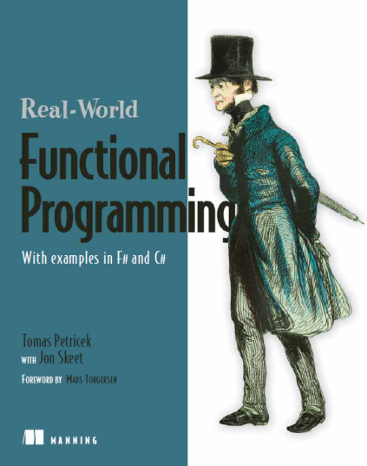

About me
Hipster F# programmer
Used F# before it was cool (blog in May 2006)
Contributed code to Visual Studio 2010
Wrote book about F#
Functional programming for C# developers
Functional and F# trainings
with Phil Trelford at SkillsMatter (London)
Ask us directly tomas@tomasp.net

Slide 3
Plan of the talk
Introduction. Buy one, get one free
Asynchronous programming patterns
Beyond asynchronous methods

Slide 4
Synchronous code
Easy to write
Can use loops and exception handling
Blocks thread and does not scale!
var wc = new WebClient();
var html = wc.DownloadData(url);
outputStream.WriteAsync(html)

Slide 5
Event-based code
Makes code more scalable
Impossible to read & write by mere mortals
Can be surprisingly popular (Node.js)
var wc = new WebClient();
wc.DownloadDataCompleted += (s, e) =>
outputStream.BeginWrite
( e.Result, 0, e.Result.Length,
res => outputStream.EndRead(res), null);
wc.DownloadDataAsync(url);

Slide 6
Synchronous code
Asynchronous code
Easy to change, easy to write
Can use loops and exception handling
Scalable – no blocking of threads
var wc = new WebClient();
var html = await wc.DownloadDataTaskAsync(url);
await outputStream.WriteAsync()
var wc = new WebClient();
var html = wc.DownloadData(url);
outputStream.WriteAsync()

Slide 7
Demo
Crawling the Web

Slide 8
Async workflows in F# and C#
C# – Return Task and add async and await
F# – Wrap in async and use let! keyword
async Task<int> PageLength(Uri url) {
var wc = new WebClient();
var html = await wc.DownloadStringTaskAsync(url);
return html.Length;
}
let pageLength (url:Uri) = async {
let wc = new WebClient();
let! html = wc.AsyncDownloadString(url)
return html.Length }

Slide 9
Async workflows in F# and C#
Async Programming Differences
Await – Can be used inside expression in C#
Compilation – Lambda functions vs. state machines
Running vs. delayed – C# creates started Tasks
Cancellation – F# inserts cancellation checks
Other differences
Availability – F# async workflows used since 2008
Built-in? Computation expressions are more general

Slide 10
Demo
Crawling the Web – adding cancellation

Slide 11
Plan of the talk
Introduction. Buy one, get one free
Asynchronous programming patterns
Beyond asynchronous methods

Slide 12
Parallel asynchronous programming
Parallel vs. asynchronous programming
Two different problems
C# Tasks are good for both
F# Async mainly for asynchronous programming
Declarative parallelism
Compose tasks to run in parallel
Task-based parallelism
Create tasks and wait for them later

Slide 13
Declarative parallelism
Run in parallel and wait for completion
Functional approach
Works nicely with F# sequences and LINQ
var docs = await TaskEx.WhenAll
(from url in pages select DownloadPage(url));
let! docs =
Async.Parallel [ for url in urls -> downloadPage url ]

Slide 14
Task-based parallelism
Start task and wait for completion later
C# Tasks are started when created
F# Async started using StartChild member
let! dl1 = Async.StartChild(downloadPage(url1))
let! dl2 = Async.StartChild(downloadPage(url2))
let! html1 = dl1
let! html2 = dl2
var dl1 = DownloadPage(url1);
var dl2 = DownloadPage(url2);
var html1 = await dl1;
var html2 = await dl2;

Slide 15
Demo
Parallel asynchronous programming

Slide 16
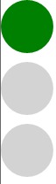
Async GUI programming
Controlling semaphore light
Using int or enum to keep current state?
Difficult to read – what does state represent?
Better approach – asynchronous waiting
Loop switches between state
Asynchronous waiting for events

Slide 17
Writing loops using workflows
Using standard language constructs
Key idea – asynchronous waiting
C# – events are not first-class values
F# – can use functional style (recursion)
Infinite loop!
let semaphoreStates() = async {
while true do
for current in [ green; orange; red ] do
let! md = Async.AwaitEvent(this.MouseDown)
display(current) }
Wait for click

Slide 18
Asynchronous GUI programming
Waiting for event
F# library provides AwaitEvent method
Can be written in C#, but wait for Rx Framework
Waiting should not block GUI thread
Running user interface workflow
Access GUI elements from GUI thread only
F# library provides StartImmediate method
C# implementation uses task scheduler

Slide 19
Demo
Asynchronous smiley game

Slide 20
Plan of the talk
Introduction. Buy one, get one free
Asynchronous programming patterns
Beyond asynchronous methods

Slide 21
Agent-based programming
Program consists of agents
Lightweight – can create lots of them
Written using asynchronous workflows
Agents communicate via messages
Communication is thread-safe
Messages are queued
Enables parallelism
Different agents vs. multiple instances

Slide 22
Simple agent in F#
Send “Hello” to the caller
Waiting for message is asynchronous
Can perform long-running I/O before replying
Calling agent asynchronously
let echo = Agent.Start(fun agent -> async {
while true do
let! name, rchan = agent.Receive()
rchan.Reply("Hello " + name) })
let! str = echo.PostAndAsyncReply(fun ch -> "Tomas", ch)

Slide 23
Demo
Creating crawling agent

Slide 24
Asynchronous sequences
Returning multiple values asynchronously
Think Task and IEnumerable in one
Supported by F# computation syntax
Works nicely with asynchronous workflows
let readLines (stream:Stream) = asyncSeq {
while canReadLine stream do
let! line = readNextLine(stream)
yield line }
async { for line in readLines input do
printfn "Downloaded: %s" line }

Slide 25
Conclusions
First-class async support
Available in F# now and in C# 5.0 (probably)
Allows interesting patterns
Parallel programming, GUI programming
F# has a few more things
Easy to call from C# using await

Slide 26

Thanks!
F# books and trainings http://functional-programming.net
Contact details tomas@tomasp.net | @tomaspetricek

Slide 27









